Slide 1
Getting Started with Neural Networks

Slide 2

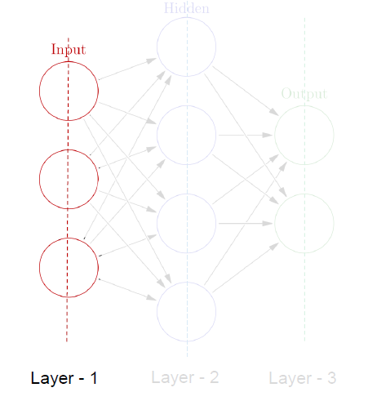

Building blocks of NN
Any Neural Network consists of three mandatory Layer
Input layer : “ Where input is feed to neural network”
Hidden Layer: Where your activation function will computed
Output Layer : Out put of the Input what we feed

Slide 3
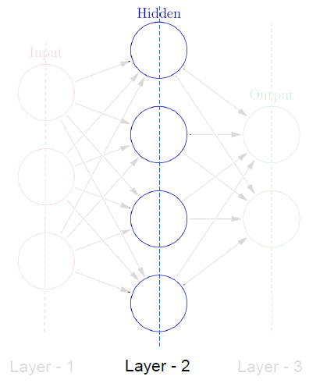
Hidden Layer
A hidden layer in an artificial neural network is a layer in between input layers and output layers, where artificial neurons take in a set of weighted inputs and produce an output through an activation function

Slide 4
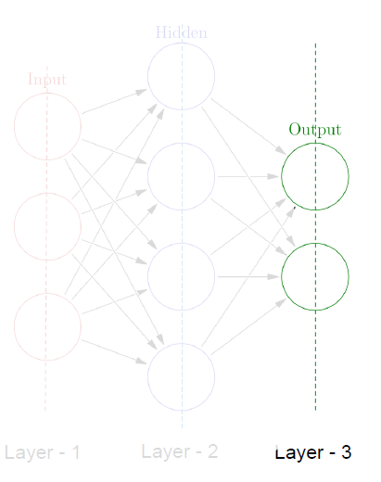
OUTPUT LAyer
Output layer — produce the result for given inputs.

Slide 5
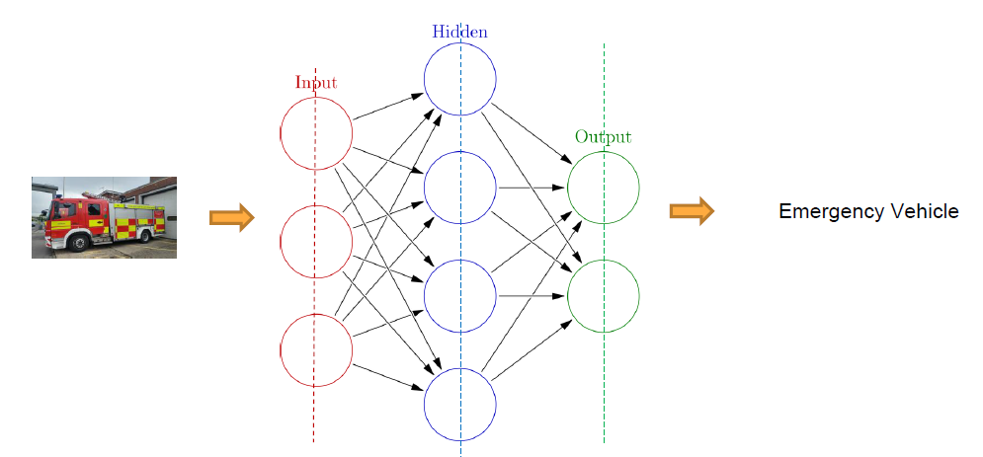

Building blocks of NN

Slide 6
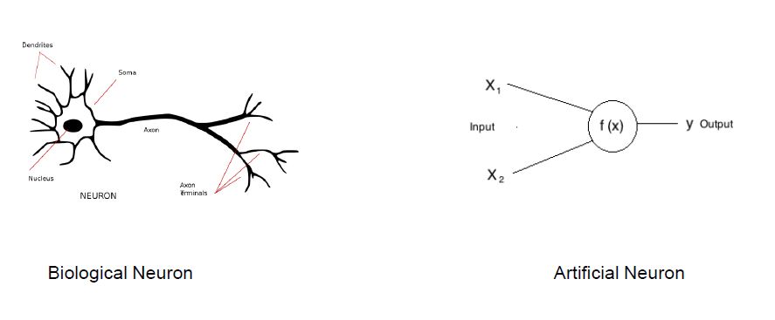
Biologically inspired Neuron

Slide 7
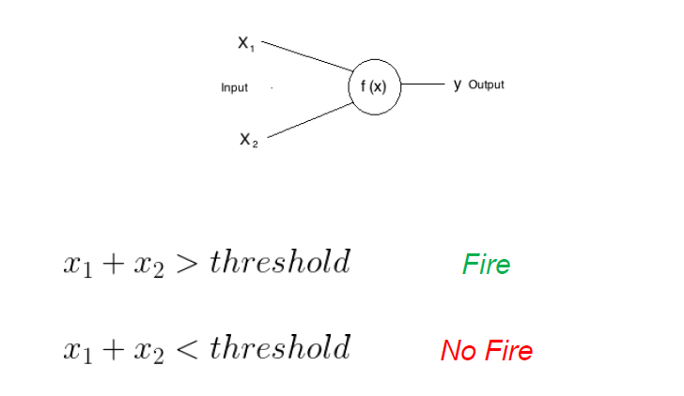
Bias of a Neuron

Slide 8
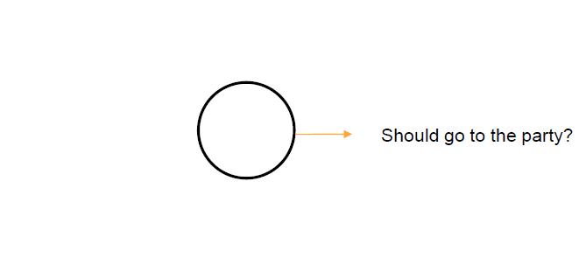
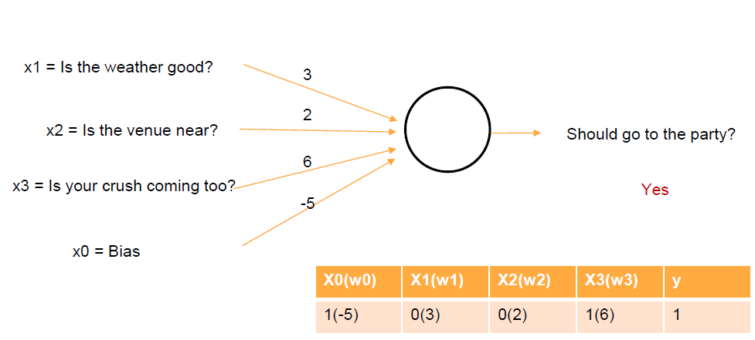
Weights of a Neuron.

Slide 9
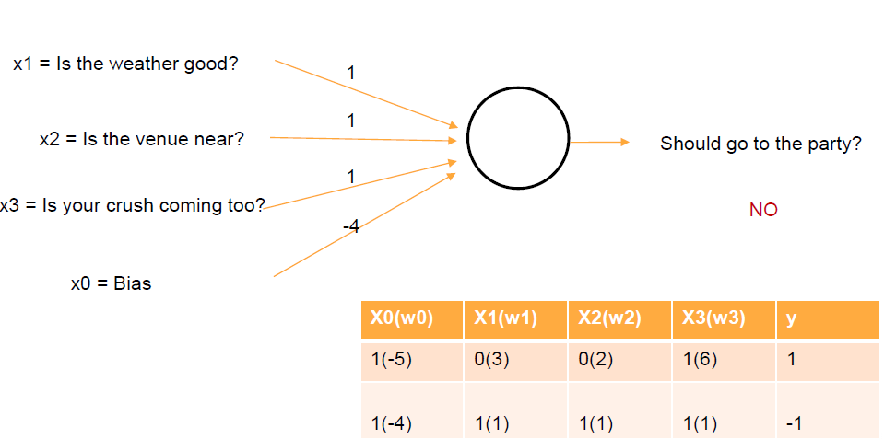
Weights of neuron

Slide 10
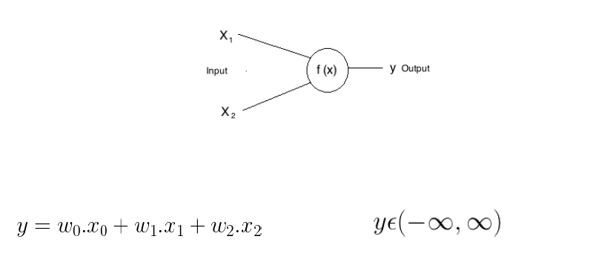
Activation Function
Neural network activation functions are a crucial component of deep learning
Activation functions determine the output of a deep learning model, its accuracy, and also the computational efficiency of training a model—which can make or break a large scale neural network

Slide 11
Most popular types of Activation functions
Sigmoid or Logistic
Tanh — Hyperbolic tangent
ReLu -Rectified linear units

Slide 12
Sigmoid
It is a activation function of form f(x) = 1 / 1 + exp(-x) . Its Range is between 0 and 1. It is a S — shaped curve.
It is easy to understand and apply but it has major reasons which have made it fall out of popularity –
Vanishing gradient problem
Secondly , its output isn’t zero centered. It makes the gradient updates go too far in different directions. 0 < output < 1, and it makes optimization harder.
Sigmoids saturate and kill gradients.
Sigmoids have slow convergence.

Slide 13
Hyperbolic Tangent function- Tanh
It’s mathamatical formula is f(x) = 1 — exp(-2x) / 1 + exp(-2x). Now it’s output is zero centered because its range in between -1 to 1
i.e -1 < output < 1 .
Hence optimization is easier in this method hence in practice it is always preferred over Sigmoid function .
But still it suffers from Vanishing gradient problem.

Slide 14
RELU
ReLu- Rectified Linear units : It has become very popular in the past couple of years. It was recently proved that it had 6 times improvement in convergence from Tanh function.
It’s just R(x) = max(0,x) i.e if x < 0 ,
R(x) = 0 and if x >= 0 , R(x) = x.
Hence as seeing the mathamatical form of this function we can see that it is very simple and efficinent .
most simple and consistent techniques and methods are only preferred and are best. avoids and rectifies vanishing gradient problem .
Almost all deep learning Models use ReLu nowadays.
But its limitation is that it should only be used within Hidden layers of a Neural Network Model.

Slide 15
Thank You

